Slide 1

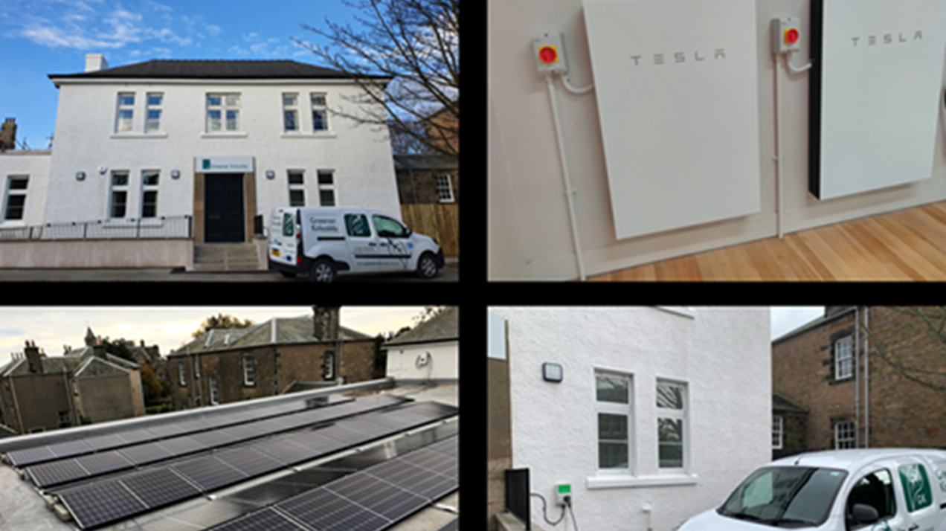
Climate-Friendly Business –
Energy Advice Strand
Notes:
3. Referrals, hand-holding, share our learning.

Slide 2
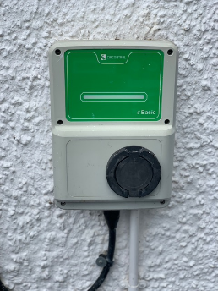
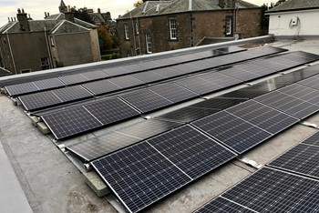
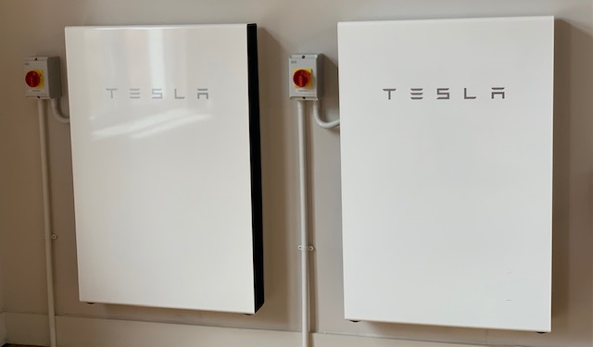
Community Demonstrator
Whole building approach to the refurbishment:
Energy efficiency improvements
Heating upgrade
EV charging – 7kW rapid charger
Solar PV – 19.2kW E-W array
Battery storage – 2 Tesla Powerwalls with 27kW capacity & Sonnen 10kW battery
Smart controls and companion apps
Batteries visible in public area and public facing information
Notes:
What changes we made to our building - and why – internal wall insulation
plus Any obstacles/difficulties - eg. conservation area, large space, E-W system, flat roof.

Slide 3
What we can do
Refer to Zero Waste Scotland’s Energy Efficiency Business Support.
Share our experience of making energy efficiency improvements to community buildings in Fife, including our own building, and of businesses we know to have successfully made similar changes.
Provide funding leads.
Create a route map to reduce carbon emissions further.
Offer additional support, such as understanding or monitoring energy use and reducing usage through behaviour changes that best suit the building and the way it is used.
Notes:
3. Referrals, hand-holding, share our learning.

Slide 4
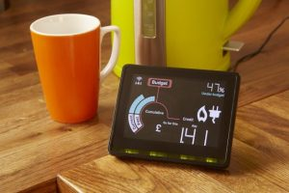




Examples of support businesses have requested
Notes:
3. Referrals, hand-holding, share our learning.

