Slide 1
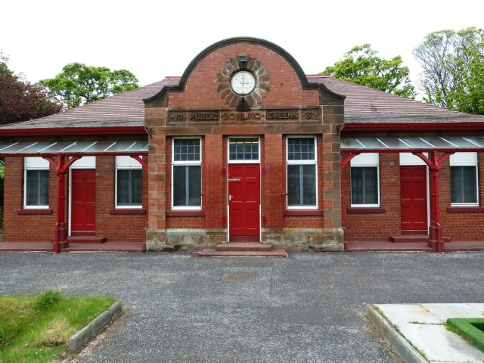
CASE STUDY:
BeVERIDGE PARK BOWLING CLUB

Slide 2
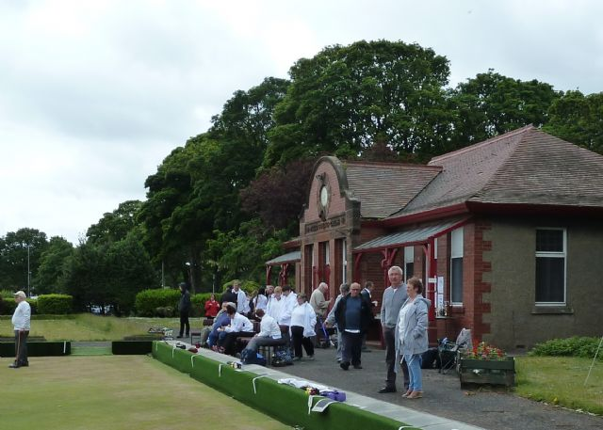
ABOUT Us

Slide 3
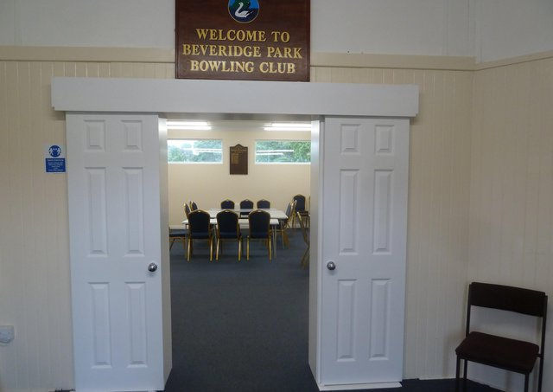
ENERGY EFFICIENCY IMPROVEMENTS
Notes:
Motivation for making improvements - Wanted to make the club more of a community hub for the Beveridge Park area. To do this we needed to do to bring it up to a decent standard.
With support from Fife Environment Trust, The Robertson Trust and Fife Council – along with a crowdfunding campaign and and public donations - we were able to refurbish and extend our building
Measures include:
Adding insulation
Upgrading old windows to more energy efficient ones
Installation of a new electric heating system
Improvements to the toilets
Installation of a disabled toilet facility
Added ramped access
Redecoration (by Community Payback team)
We are currently working with Greener Kirkcaldy’s energy advice team to take steps increase the building’s energy efficiency and reduce the energy we need to use. They have:
Advised on making the best use of the current heating system and lower carbon heating options for the building.
Recommended installing a new internal door to prevent heat loss
Installed an energy monitor to help us measure our energy usage.
Signposted to Zero Waste Scotland’s Energy Efficiency Team - they have now provided us with an assessment of measures that we could take forward.

