Slide 1


Greener Kirkcaldy
Food Waste Reduction Business Support
Gerry Boyle
- Zero Waste Scotland
zerowastescotland.org.uk
@zerowastescot

Slide 2
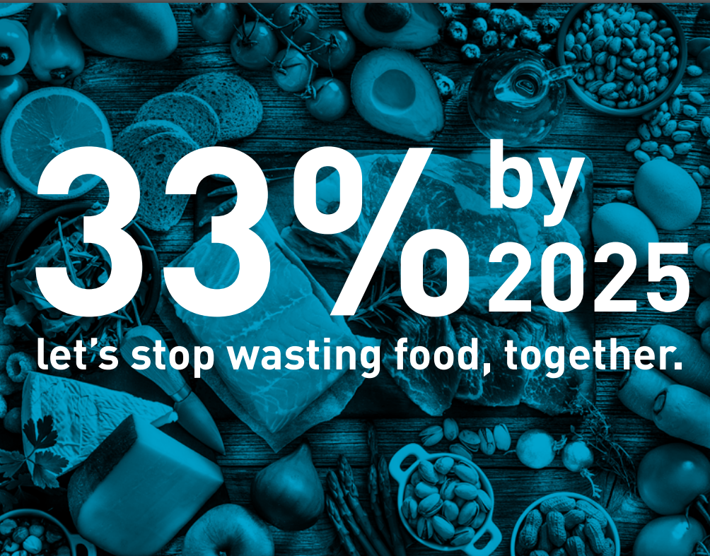
Scottish Government Target
Notes:
Scotland’s ambitious target is to reduce its food waste by one third by 2025. This means that the country must prevent around 297,000 tonnes of food waste each year. This is not any ONE’s responsibility it is all of our responsibility Business, private, public and as consumers in our own homes

Slide 3
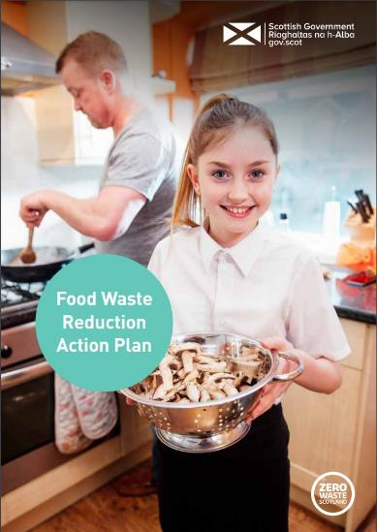
Food Waste Reduction Action Plan​
This plan is designed to engage with every part of our food supply chain and waste hierarchy.
It will:
Reduce unnecessary demand and avoidable waste and optimise how we use organic resources.
It will support technical and business innovation.
It will help to make food waste unacceptable in Scotland.
​
​
​
Notes:
Scotland is addressing its food waste problem with this ambitious Action Plan designed to: reduce unnecessary demand for food; improve how we produce, store and cook food so that we waste less; increase food recycling rates and; make better use of food waste as an organic
resource.
Improved monitoring and infrastructure
Food waste monitoring and measurement methods have developed considerably over recent years because of better food waste collection. However, there are still considerable gaps in our knowledge especially in HaFS and these must be addressed so that we can accurately monitor and report on our progress and proactively target sectors that need enhanced support or action.
Sector Leadership
Everyone in Scotland is expected to play their part in tackling food waste and reaching our target. Both the public and private sectors have huge influence and the potential to innovate successfully. Partnerships like ours collaborating on projects and supporting the sector are essential to the achieving our lofty target.
Public Engagement and Communication
Households and consumers are the biggest source of known food waste in Scotland, although their behaviour is heavily influenced by the public and business sectors. A consistent message and sustained communication designed to change their individual behaviours and drive change throughout the food supply chain.
Supporting delivery of a new approach to food waste
Addressing food waste is not simple and requires a coordinated multi-stakeholder approach to achieve the target in the most cost effective and efficient way. Coordination throughout the food and drink surplus and waste hierarchy will not only result in higher food waste prevention but in greater opportunities to exploit our organic resources and contribute to Scotland’s economy.

Slide 4
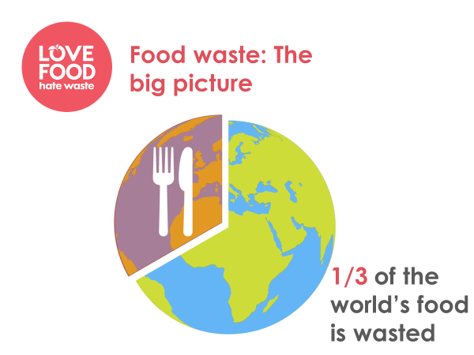
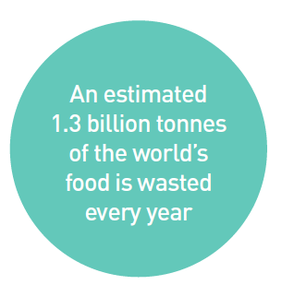

Impact of Food waste
Estimated to be worth $1 trillion
When food is wasted, so too is the energy (and associated carbon emissions) that went into growing, harvesting, transporting, processing, and preparing it
Global emissions from food waste are 3 times that of aviation travel.

Slide 5
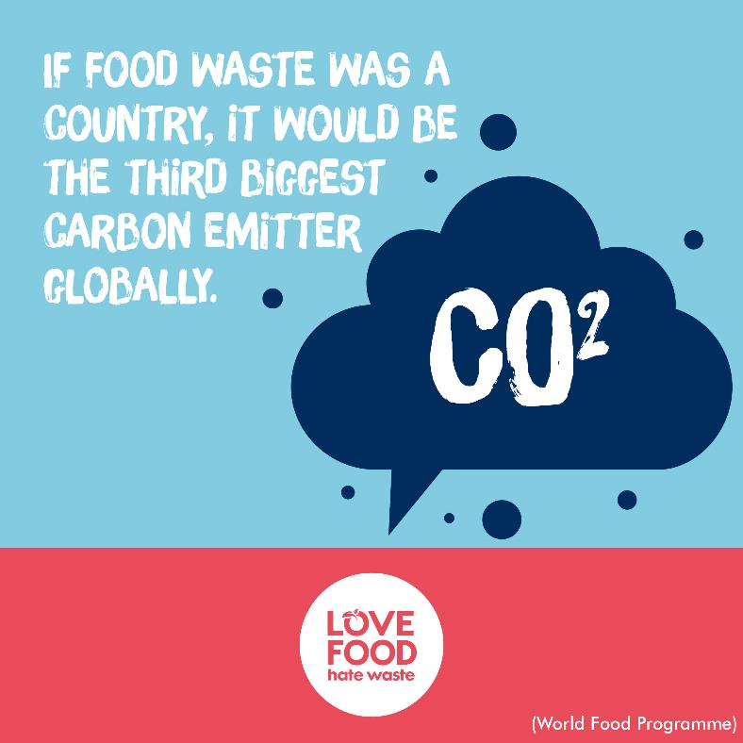
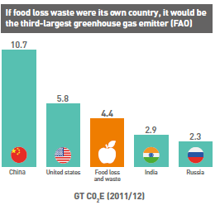
Impact of Food waste
Food waste sent to landfill gives off methane gas – more damaging than carbon dioxide
Estimates indicate that if it were a country, food loss and waste would be the third-largest greenhouse gas emitter behind China and the United States.
(United Nations, 2016).
Notes:
1kg of food waste produces carbon emissions equivalent to landfilling 25k plastic bottles

Slide 6

Hospitality & Food Service
Improved food waste data from the sector
Increase awareness of the food waste impact to HaFS businesses
Highlight the financial benefits of food waste reduction
Provide guidance on measuring & monitoring waste
Tools and interventions to reduce waste
Pilot projects and case studies to further support the sector
1-2-1 business support ​
​
Notes:
How do we combat food waste

Slide 7




Food waste currently cost Scottish Hospitality Businesses £215m p.a.
Filling just one wheelie bin every week costs £12,500 p.a.
1 in 6 meals
served ends up going to waste
Every dish prepared, creates £1 worth of food waste
Hospitality & Food Service
Notes:
Data HaFS Headlines & costs

Slide 8


Hospitality & Food Service
Where does food waste occur?
Food preparation
Examples are vegetable peelings, excess meat parts, and eggshells. Get creative with trimmings and excess to make pates, soups and stocks.
Customer plates
Although you can’t control how much your customers leave behind, you can apply portion control.
Even using smaller plates can help! Or you can start using a doggy bag scheme, encouraging your customers to take home leftovers.
Spoilage
It may seem cost effective to buy in bulk, but perishable items can spoil quickly, costing you (and the environment) more in the long run.
Cross-contamination can also occur as a result of poor storage and preparation practices.
Plates 34%
Prep 45%
Spoilage 21%

Slide 9
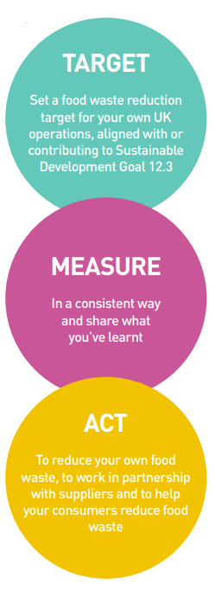
Measuring and monitoring – Target, Measure, Act
Measuring and monitoring your waste isn’t difficult
Decide what information you need then you put in place a system that will collect the data
Analyse and evaluate the data - it provides an important baseline measurement and gives you information to make decisions
Continued monitoring will gauge the effectiveness of any actions put in place, and help keep staff motivated
Sign up to the TMA commitment

Slide 10
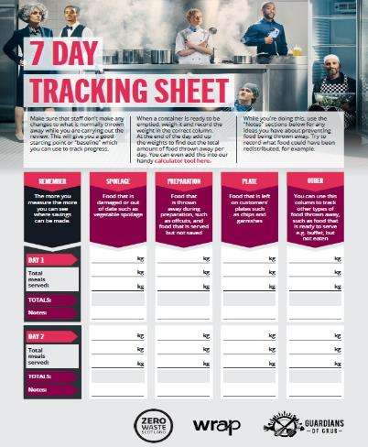
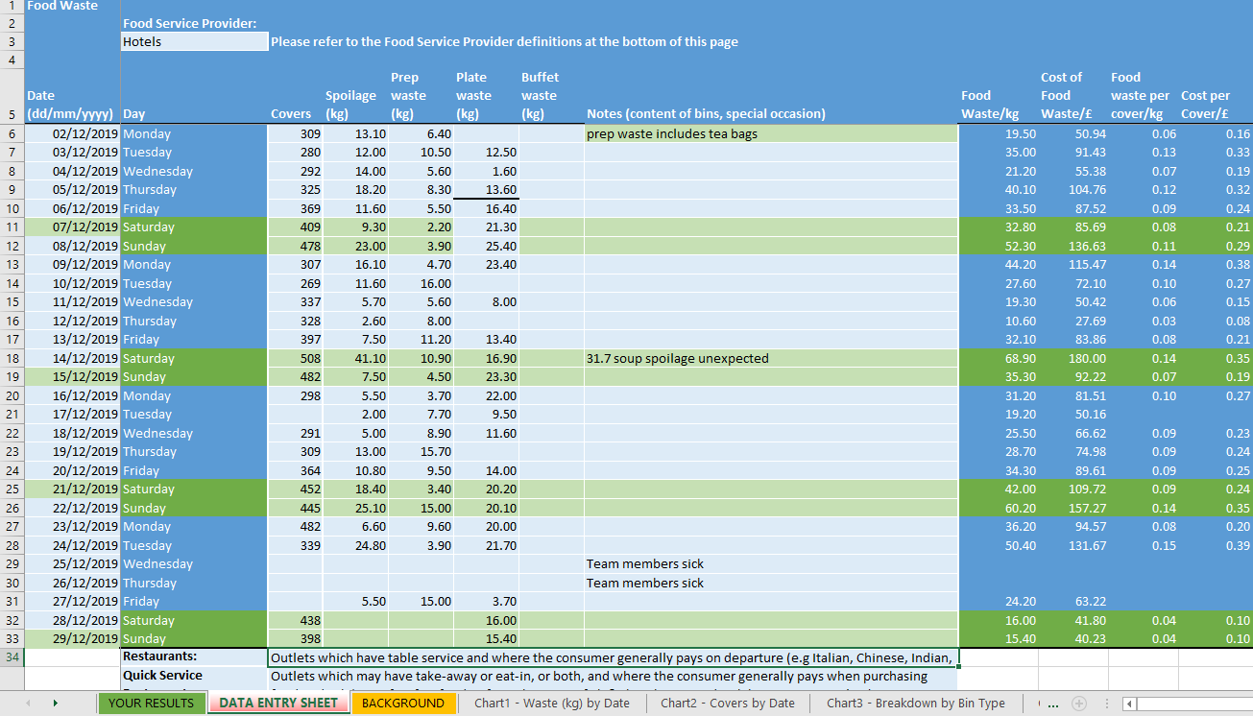
Hospitality & Food Service

Slide 11

Hospitality & Food Service
Spoilage Actions:
Stock rotation system FIFO
Deals before expiry
Review storage temps
Talk to your suppliers
Consider local
Forecasting demand
Cook to order
Preparation Actions:
Skin on ??
Chopping technique
Pre-prepared ingredients
Formalise recipe instructions
Ingredient cross-over
Remove less popular dishes from menu
Food redistribution
Plate Waste Actions:
Reduce portion sizes
Advise customers
Optional garnishes & smaller side options
Plate size
Doggy bag scheme
Notes:
LOW hanging fruit Every aspect of HaFS has a part to play in reducing food waste . Illustrate how each function i.e. Kitchen, Front of House, Cleaning, Management & Consumer can influence food waste reduction.
​

Slide 12
Food Waste Reduction Business Support ​
40k
Tonnes of Co2 saved
We offer free support and advice to help cut your businesses’ food waste, save money, and associated carbon emissions. ​
Support ranges from guided help through our food waste reduction tools and resources journey, to 1-2-1 audits. ​​
​​
All our support will help you to reduce food waste by helping you understand: ​​
​
How much food waste you are producing and where your hot spots are​.​
​
What changes you can make and measures you can implement to reduce food waste.​
​
How to shout about what you are doing and be a showcase organisation to influence others.
​
​
​
Equivalent
of running a fridge for a year for 85,839 homes
£8m
of savings identified

Slide 13
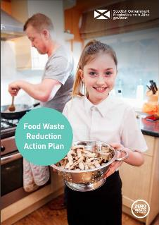
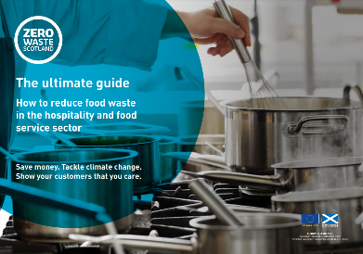
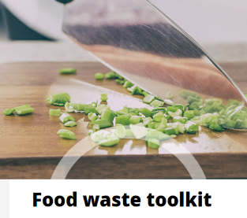
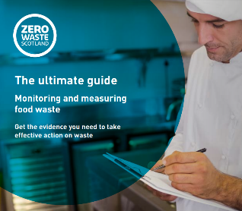


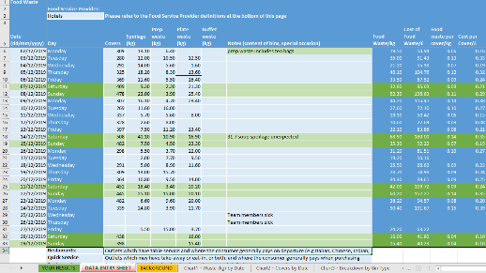
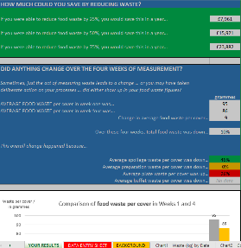
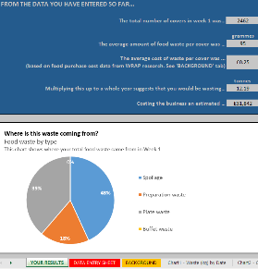
Food and Drink -
Resources

Slide 14

Get in Touch​
gerry.boyle@zerowastescotland.org.uk​
food.drink@zerowastescotland.org.uk​

