Slide 1
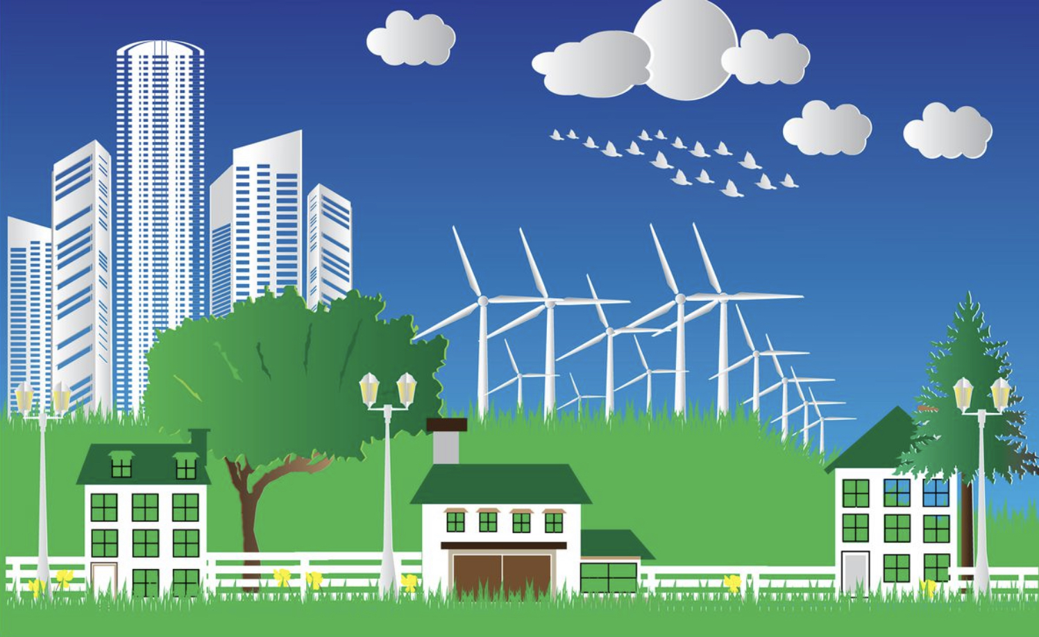

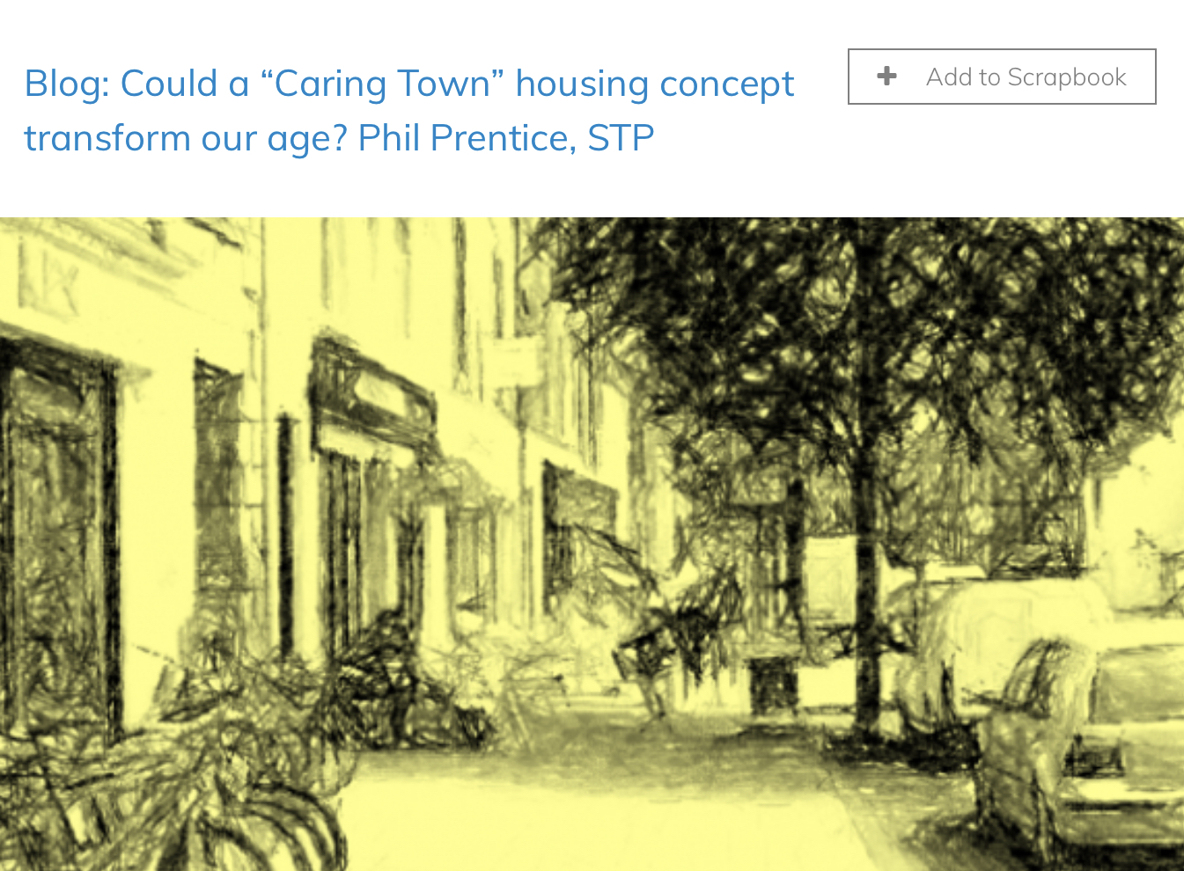
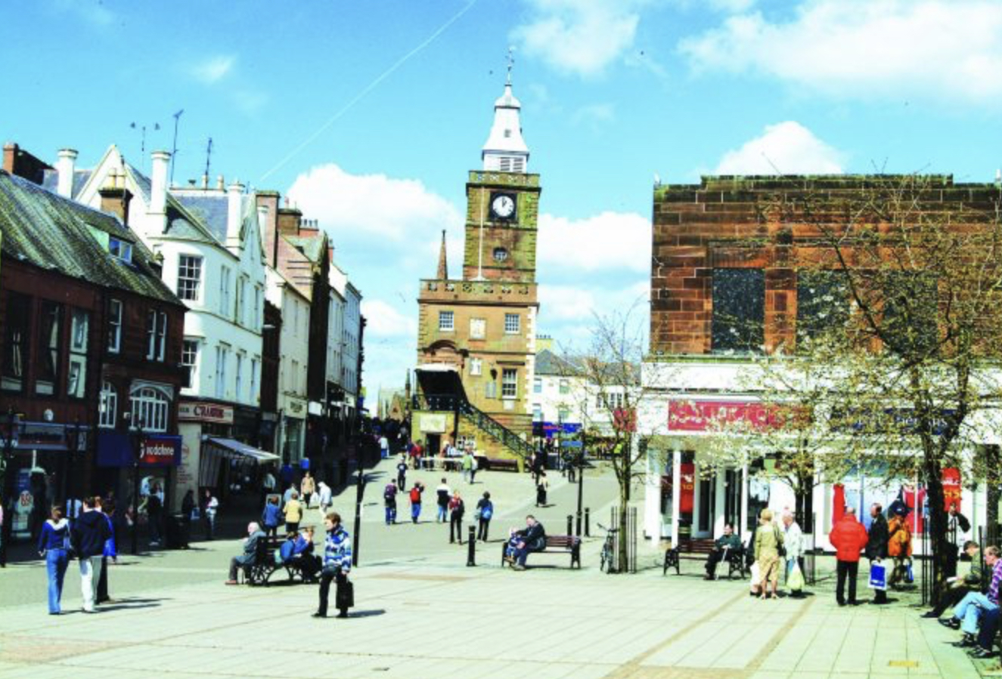
Notes:
Climate
Pop up or pocket parks
Tree canopies and planters
Shade, shelter and flood prevention
Community growing, green roofs and walls, waste reduction and circular economy initiatives. Contributes to net zero, improves biodiversity, brings community together, makes place more attractive and looked after
Digital –
inclusion, economy, community – social media, community web platforms
Community
Support networks, Housing, events, activities, Vulnerable, volunteering
Caring
Create a more caring environment linked to health and housing, new social enterprise opportunities

Slide 2
COVID19
Physical distancing and public health infrastructure: Supply or installation of distancing markers, outdoor protection while queuing, street marking, protective screens, PPE, and hand sanitising equipment.
Climate
Pop up parks, Community gardens or orchards, Allotments and growing projects, Planting – planters, trees, baskets, Recycling and waste reduction, Energy efficiency projects
Community
Outdoor benches, Shop front schemes / public realm
Community halls, shops, EV, Cycling, walking infrastructure
Providing information for local residents/visitors (such as in the lead up to Christmas) on safe local shopping, business, community and leisure opportunities.
Create local online job or volunteering platforms

Slide 3
Economy
- Marketing and Advertising, using the Scotland Loves Local communications pack resources, on what local businesses have to offer.
- Develop social media, print and local campaigns around a ‘Love Local’ message.
- Small scale improvements and information e.g. route maps/signage/small scale infrastructure/trails to join up neighbouring villages/suburbs/assets as a single destination
Projects to encourage cooperatives, independents and social enterprises to develop local initiatives, collaborations and ownership
Virtual villages, communities, delivery etc

Slide 4
